Slide 1


An Introduction
Michał Poręba
Explorer DBA in Wales MCSE: Data Management and Analytics Senior DBA at Vizolution in Swansea
https://dbain.wales https://twitter.com/michalinwales

Slide 2
The Good, the Bad and the Avoidable
Transact SQL Practices and Cautionary Tales for Developers

Slide 3
What is this talk about?
Transact-SQL for the Server
Transact-SQL for Developers
The Good Whatever you do it will work just fine.
The Bad It will work fine until it doesn’t.
The Avoidable How to avoid the bad.
The Good How to write good Transact-SQL.
The Bad How to avoid common mistakes.
The Avoidable The internet is full of advise as common as it is outdated on how to solve problems that no longer exist. Use the latest technology when possible.

Slide 4
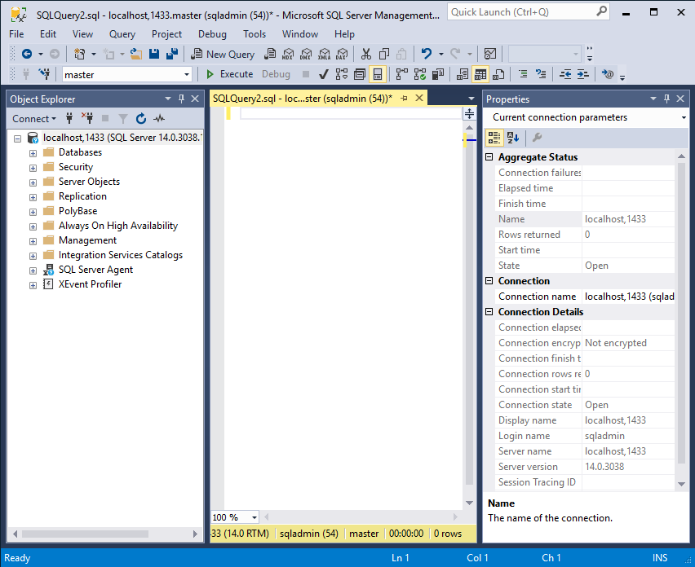
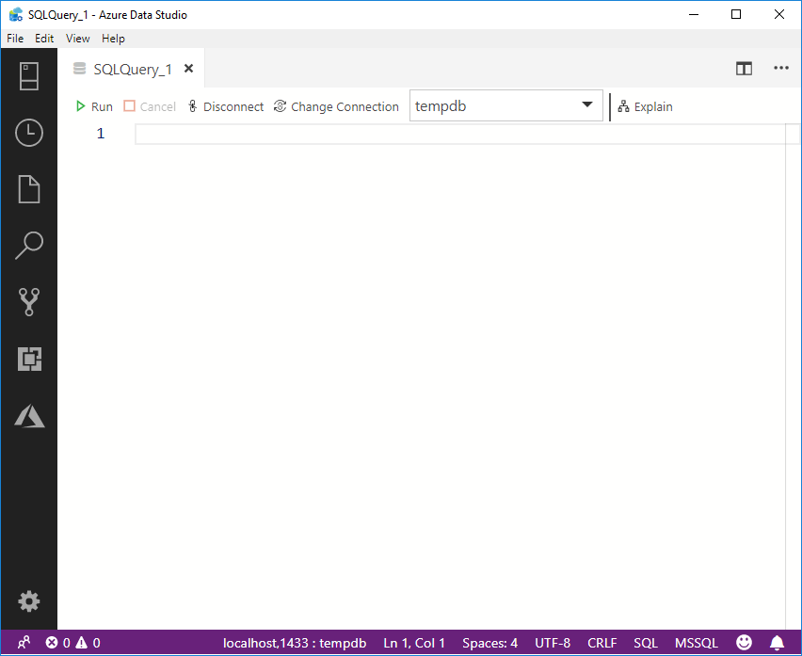
IDE for Transact-SQL Development
SQL Server Management Studio
Azure Data Studio

Slide 5
IDE for Transact-SQL Development
SQL Server Management Studio
Azure Data Studio
Based on Visual Studio
Traditional SQL Server Experience
Released independently of SQL Server
A lot of functionality
Based on VS Code
New, cross platform and open source
Very active development
A lot of free extensions

Slide 6
IDE for Transact-SQL Development
SQL Server Management Studio
Azure Data Studio
Is good for you if you do a lot of:
Complex configuration and administration
Security configuration and management
Database diagrams and table designers
Use sqlcmd mode or live query stats
Pointing and clicking rather than typing
Should be your choice if you:
Spend most of your time developing queries
Work with multi-file projects
Need source control
Need to quickly chart or visualise results
Prefer the keyboard experience
Full feature comparison: https://docs.microsoft.com/en-us/sql/azure-data-studio/faq?view=sql-server-2017

Slide 7
Does SQL code quality matter?
A quick demo based on a post by Michael J Swart (the Database Whisperer)
http://michaeljswart.com/2013/01/joins-are-commutative-and-sql-server-knows-it/

Slide 8
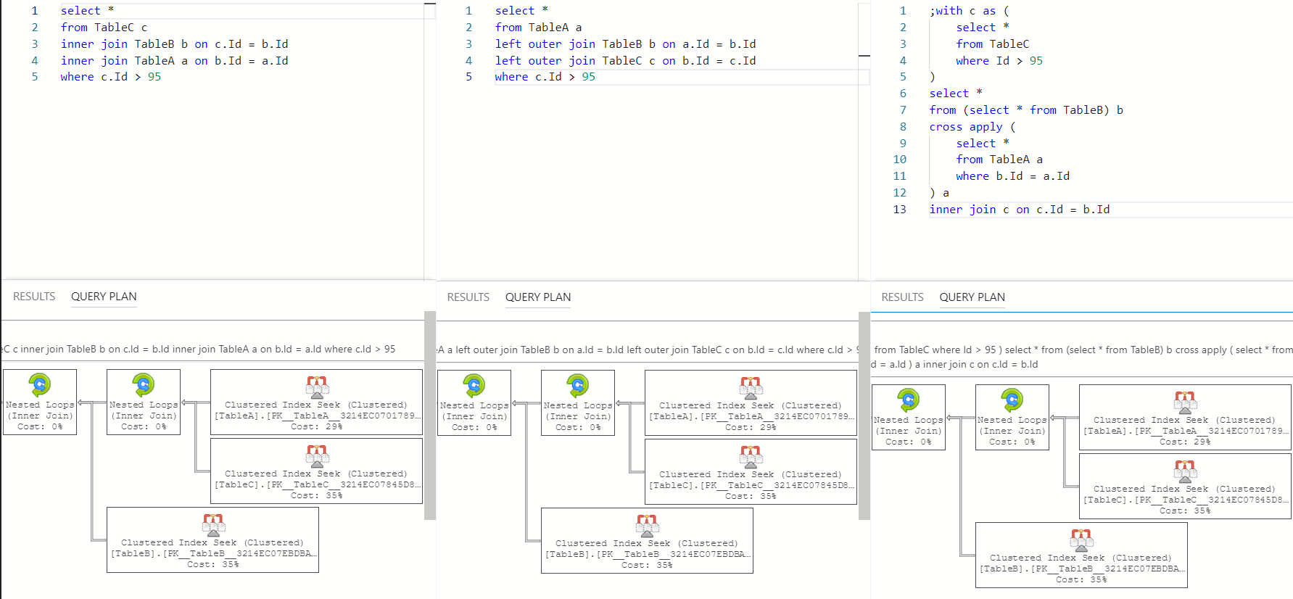
Three sets of instructions but only one plan.

Slide 9
It doesn’t matter how you write your SQL!
Transact SQL is a declarative language.
Instead of providing instructions telling the database engine how to do something a database developer describes in code what needs doing.
Query Optimiser is responsible for figuring out how to do it best.
It doesn’t matter ^{[1]} how the T-SQL code is written as long as it is valid.
[1] That’s just a theory. In practice it matters, in fact it can be very important.

Slide 10
First Scenario
Creating a stored procedure

Slide 11
First Scenario - Requirements
Write a script that will create stored procedure that will
Find a database object with a name starting with a specified string.
Return object_id and name.
When NULL is passed all objects should be considered.
Return first N matching objects, where N can be specified at runtime.
The results should be ordered by object_id
It should be safe to execute script multiple times on the same database.

Slide 12
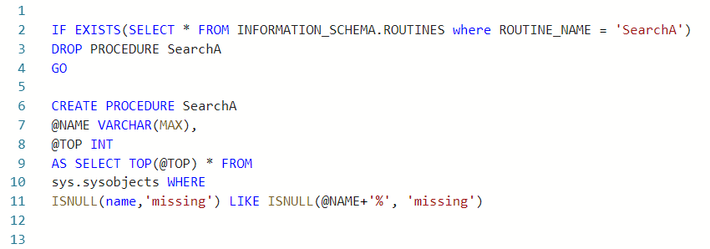
First Scenario – First Attempt

Slide 13
ALL CAPS SQL^{[2]}
The Good No need for syntax highlighting Helps if you are stuck in 1980s or if you use applications that are notepad-like.
The Bad Time and effort wasted Less readable than lower-case text (https://en.wikipedia.org/wiki/All_caps) Sometim
The Avoidable Yes, it is. Even on case sensitive instances. Capitalization of keywords matters only to people. In ADS it is possible to change settings so that intelliSense is using lowercase.
[2] This is a highly flammable topic, so let’s get it out in the open first.

Slide 14
INFORMATION_SCHEMA
The Good It is the ANSI standard The code is more portable to other RDBMS systems
The Bad Not all available information can be exposed in INFORMATION_SCHEMA
The Avoidable Yes. In fact, Microsoft recommends using System Catalog Views over other ways of obtaining this type of information. (https://docs.microsoft.com/en-us/sql/relational-databases/system-catalog-views/catalog-views-transact-sql?view=sql-server-2017)

Slide 15
System Compatibility View – sys.sysobjects
The Good It will run on SQL Server 2000
The Bad Included only for backwards compatibility Does not include information about new features from 2005 onwards
The Avoidable Yes. Use the System Catalog Views in the sys schema. For sys.sysobjects it is sys.objects

Slide 16
Missing Indentation and BEGIN…END
The Good A few keystrokes less
The Bad Makes it more difficult to read the code
The Avoidable Yes. Indentation and all white spaces are ignored by SQL Server. Being and end are optional in stored procedure declaration as it has to be the only statement in the batch. Still, not everything that can be avoided needs to be avoided.

Slide 17
Missing Batch Separator (GO)
GO is not a keyword.
It is useful if multiple statements are in the same file.
If multiple stored procedures are defined in the same file make sure that you end each stored procedure with a go.
But there is no need to use go after every statement. Don’t use it until it is necessary.

Slide 18
Function on a column in WHERE
The Good That’s no good
The Bad Forces full table scan ignoring any indexes on that column It will work in development on a small data set, but will cause problems on larger data
The Avoidable Yes. Here it is an example of misguided attempt at avoiding problems with ternary logic in the where clause. Whatever the reason, if only possible, functions should not be used on columns in where part of a query.

Slide 19
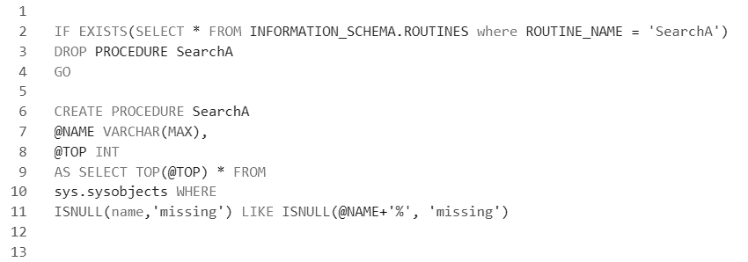
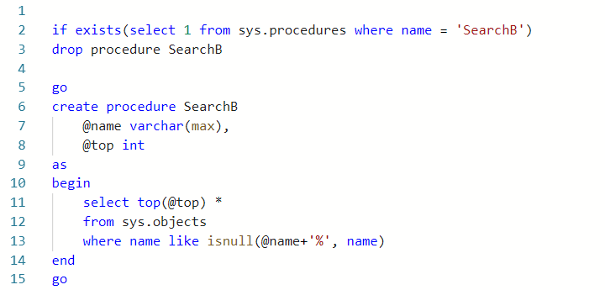
First Scenario – Second Attempt

Slide 20
No explicit schemas for objects
The Good A few keystrokes less
The Bad If you are not using schemas yet, you may in the future As the application grows historic code might start behaving erratically It can cause multiple execution plans for what appears to be the same query
The Avoidable Yes. It is a good practice, and in number of applications it is necessary: using scalar functions or using schemabinding for example.

Slide 21
Function on a column in WHERE – again!
The Good That’s no good
The Bad Forces full table scan ignoring any indexes on that column It will work in development on a small data set, but will cause problems on larger data
The Avoidable Yes. This attempt looks better, but still when the @name is NULL it will force a full table scan just to make sure that name is really equal to name.

Slide 22
Drop and create pattern
The Good It’s common practice, must be for a good reason. Even SSMS generates code like that!
The Bad Any permissions associated with this procedure will be lost. There is a moment when the object is missing.
The Avoidable Yes. With just a little bit more code a stub of a missing object can be created first, and then it can be altered with the required implementation.

Slide 23
SELECT *
The Good Whatever the future brings I will be covered
The Bad Adding or removing columns might break your queries even if you don’t use those columns Indexing is more difficult and mostly ineffective Can use more IO, memory and network than is necessary
The Avoidable Simple, just name the columns you need.

Slide 24
SET NOCOUNT ON
The Good There is some evidence that it doesn’t matter any more (https://sqlperformance.com/2016/02/t-sql-queries/nocount)
The Bad Why send stuff over network nobody needs?
The Avoidable It is still a good practice to put set nocount on; at the top of any stored procedure.

Slide 25
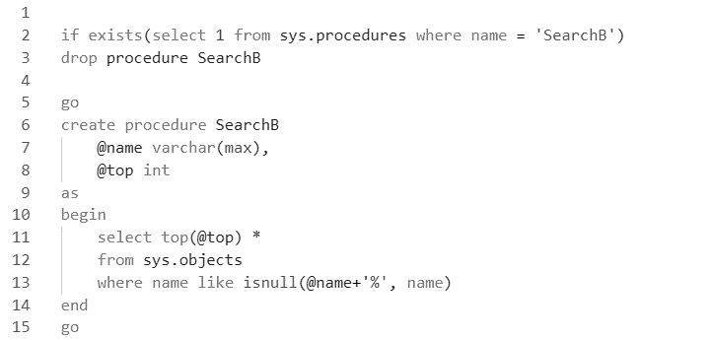
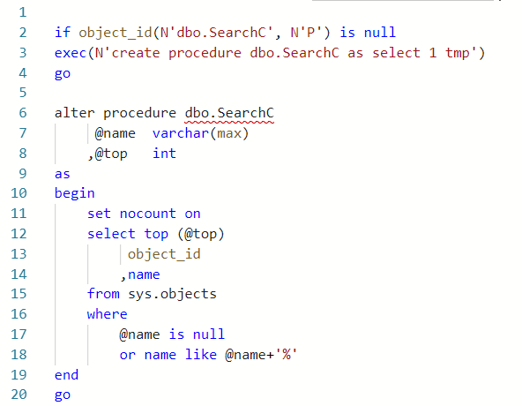
First Scenario – Third Attempt

Slide 26
Implicit type conversions
The Good You don’t have to think about data types much
The Bad Implicit data conversions can cause index scans Implicit data conversions can make the indexing futile Implicit data conversions can kill performance
The Avoidable Think about types. There are differences between Unicode or ASCII strings, the precision of types matter.

Slide 27
Depending on implicit ordering
The Good Less text to write
The Bad Sets are not ordered. Any apparent order is just an illusion As the data grows, the query might go parallel As the data grows different index might be chosen by the QO
The Avoidable Don’t risk it! Always put explicit order by on queries that require data in a specific order

Slide 28
CREATE OR ALTER
The Good The code gets cleaner. There is less to type, less to read, all strongly typed.
The Bad Works only if you only use SQL Server 2016 SP1 or later
The Avoidable Of course, if you don’t need to support earlier versions of SQL Server.

Slide 29
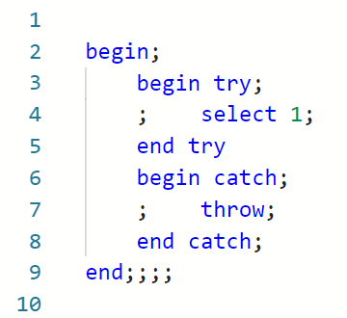
Semicolons!
Some statements (MERGE, THROW, ;WITH) need them!
Some less common statements (e.g. SEND, RECEIVE, BEGIN DIALOG) may need it too.
Not ending a statement with a semicolon is now officially a deprecated feature
It is unlikely Microsoft will ever remove that feature but why risk it?
The Weird SQL Server appears to be very inconsistent in how it treats semicolons. Microsoft allows not to use them in most cases yet says it is a deprecated features. At the same time it is a valid Transact-SQL to put semicolons where they make no sense!
Use common sense. Put semicolons where they make sense!

Slide 30

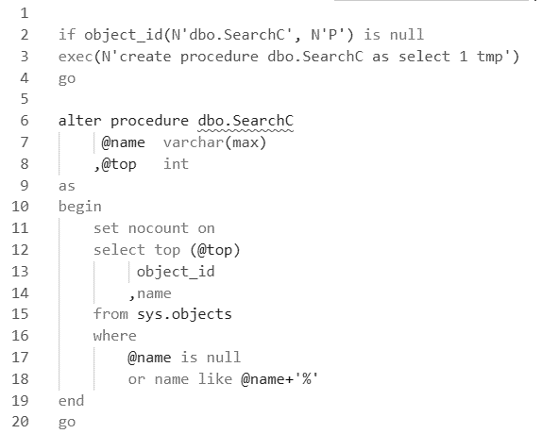
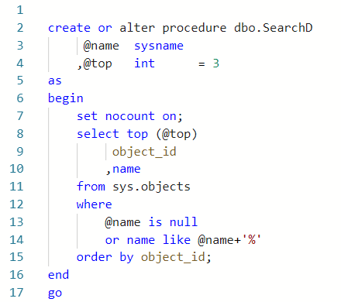
First Scenario – Fourth Attempt

Slide 31
The QO doesn’t care which one you write. Do you?
Which one is better for developers?
Which one is better for servers?

Slide 32
First Scenario – Lessons Learnt
Think about performance Be specific in your SELECTs Avoid functions in your WHEREs Think about types and conversions Use SET NOCOUNT ON; just in case Be careful with DISTINCT
Be explicit Always use explicit schemas When order matters use ORDER BY Use BEGIN and END to structure your code
Keep up with the times Lowercase is at least as good if not better Don’t try to be compatible with the whole world Go easy on the GO
Transact-SQL is code Treat it like code Keep it consistent Think maintainability Think readability Care about your code, even when the Server doesn’t.

Slide 33
Second Scenario
How to aggregating strings or why not to trust the Internet.

Slide 34
Second Scenario - Requirements
Write a script that for each object type in sys.all_objects will display the names of the objects.
Only the first 10 object names in alphabetical order should be considered.
There should be one row of data per type.
All names for a group should be in a single string, separated by a comma.
I know that it violates the 1st Normal Form. Sod Codd, end user is always right!

Slide 35
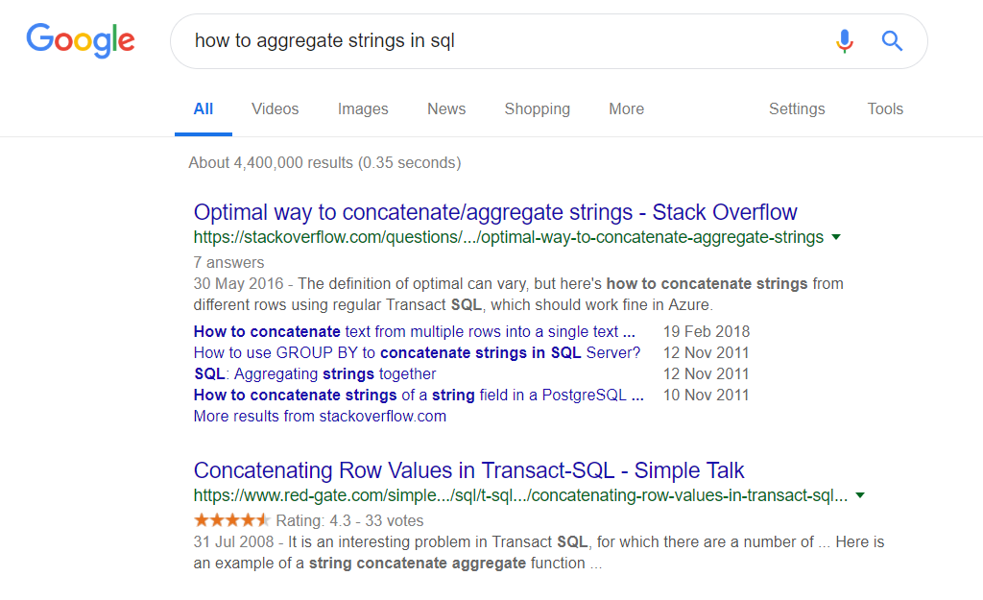

Slide 36
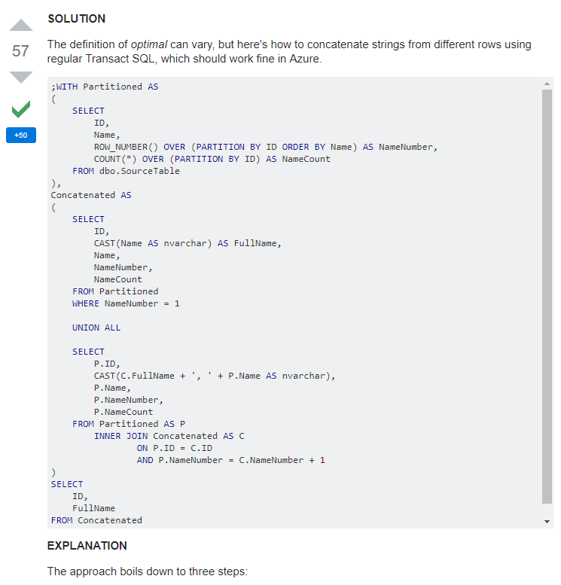
I can do it!
First result in Google!
Stack Overflow – the Accepted Solution
Regular Transact SQL
Should work in Azure
Plenty of upvotes, the Internet agrees
Code looks clean, they know their stuff
But that’s a lot of code
Surely it doesn’t have to be that complex
What? Isn’t it a recursive query?
What if I need more than 100 values?
How will I explain it in code review?
What was that second link, Google?

Slide 38
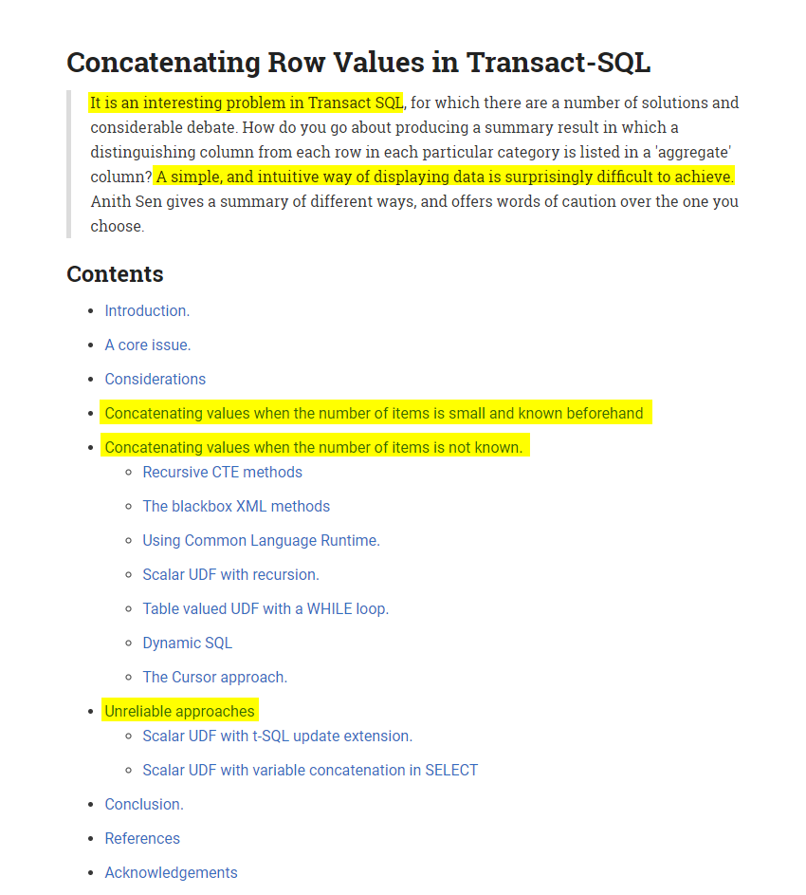
Red Gate
Where is the code?
Oh, that’s just the contents…
This cannot be that hard!
… an interesting problem
A simple is difficult to achieve?

Slide 39
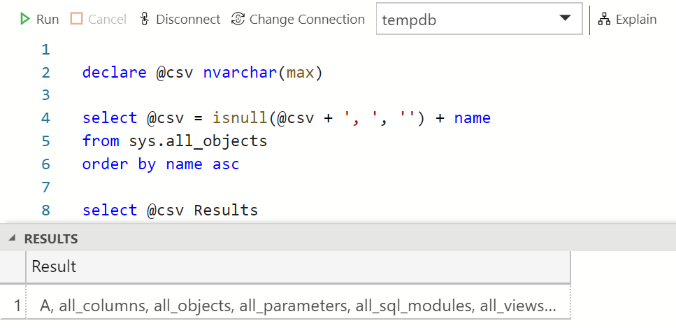
Second Scenario – First Attempt (the Unreliable)

Slide 40
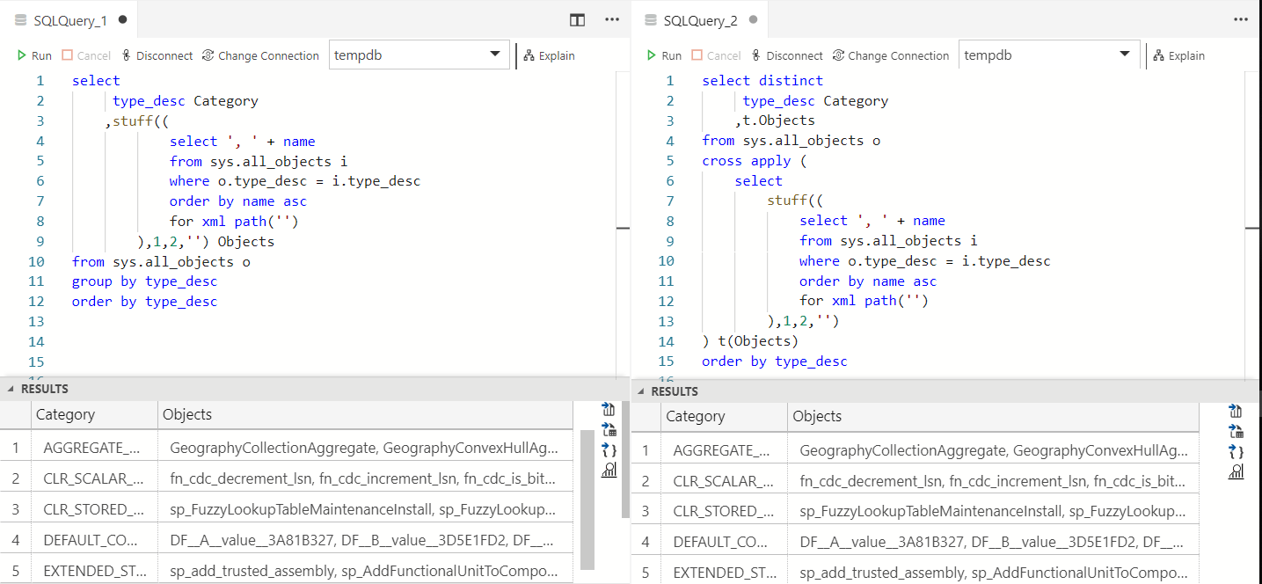
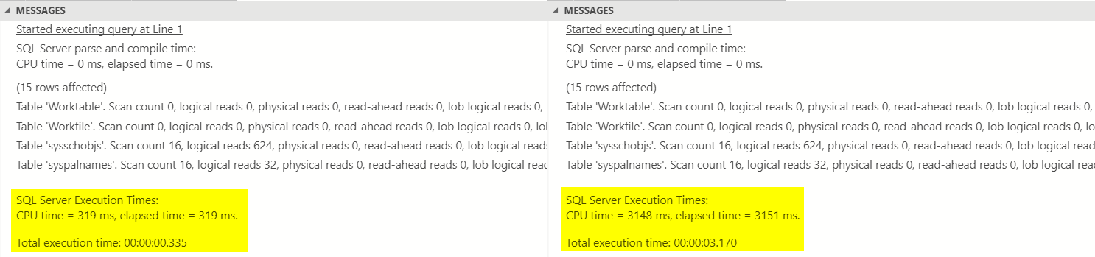
Second Scenario – Second Attempt (XML)
This is 10 times slower!

Slide 41
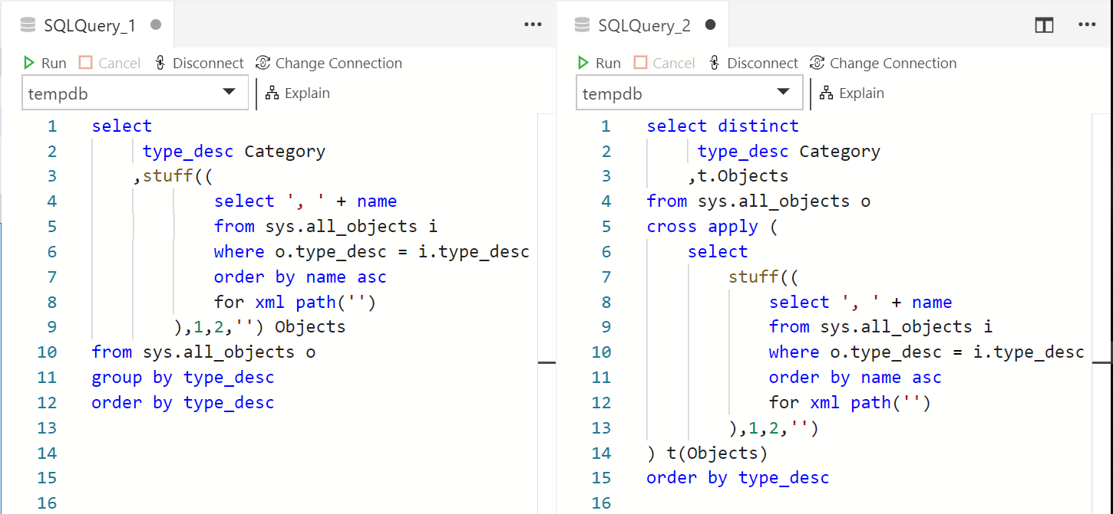

Slide 42
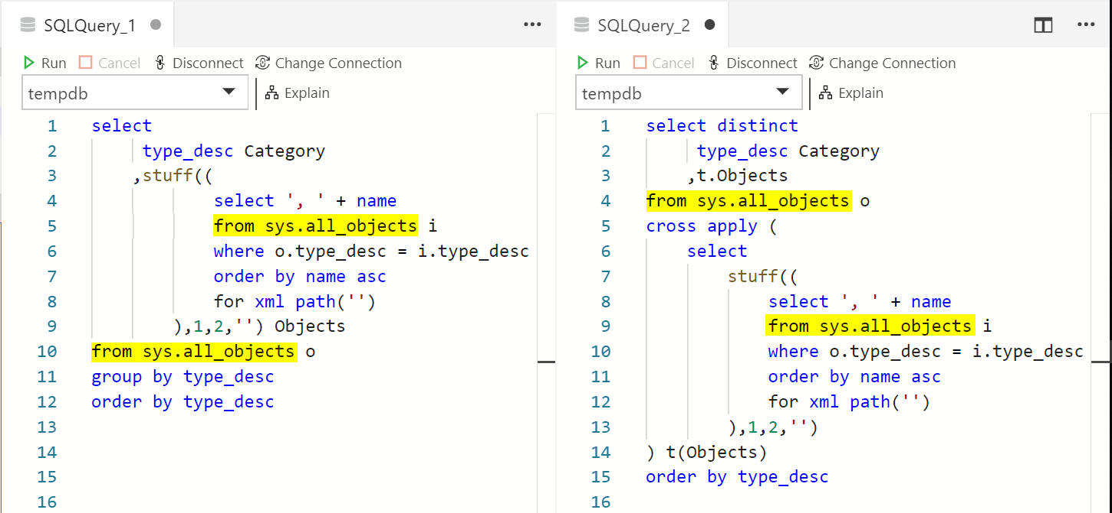

Slide 43
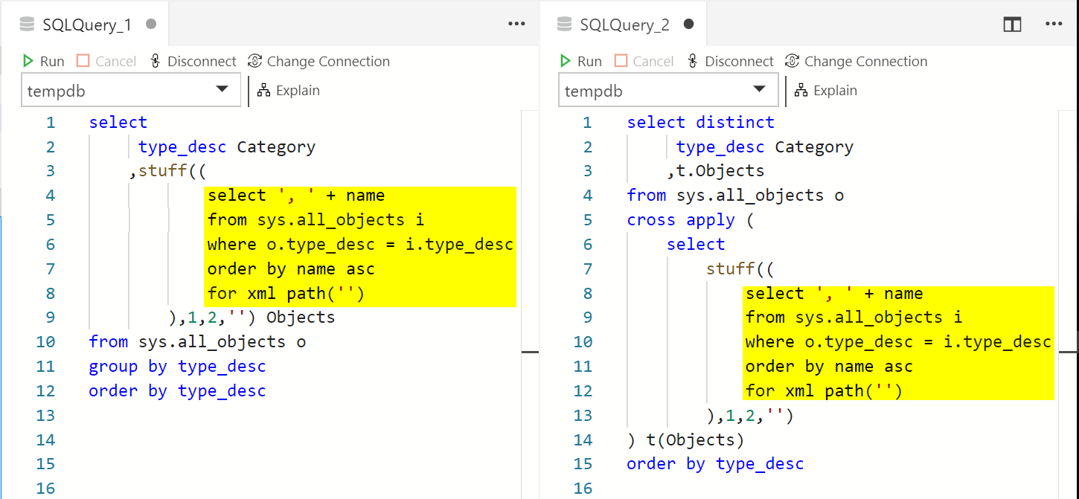

Slide 44
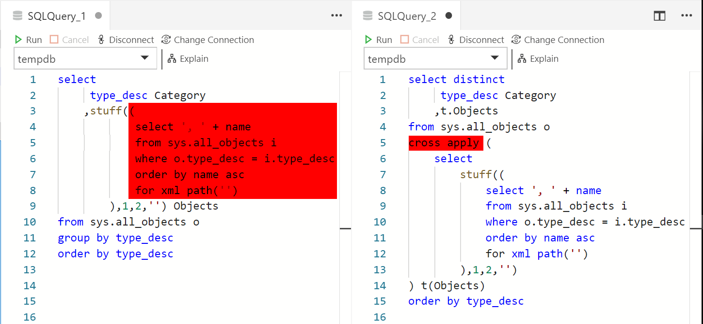

Slide 45
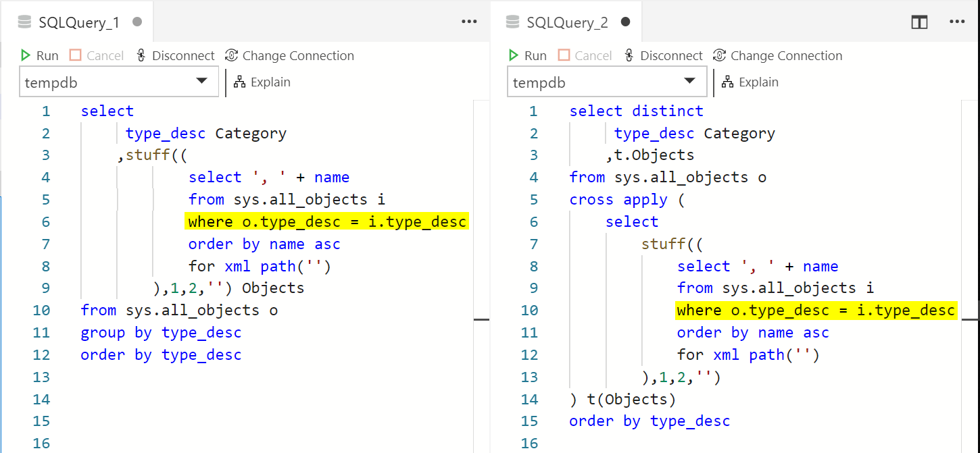

Slide 46
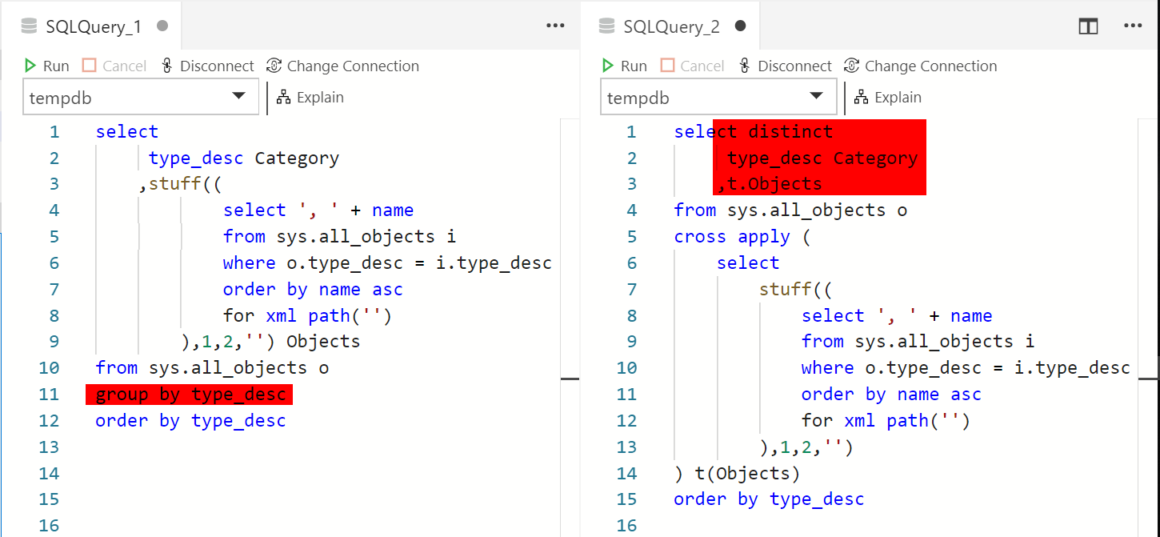

Slide 47
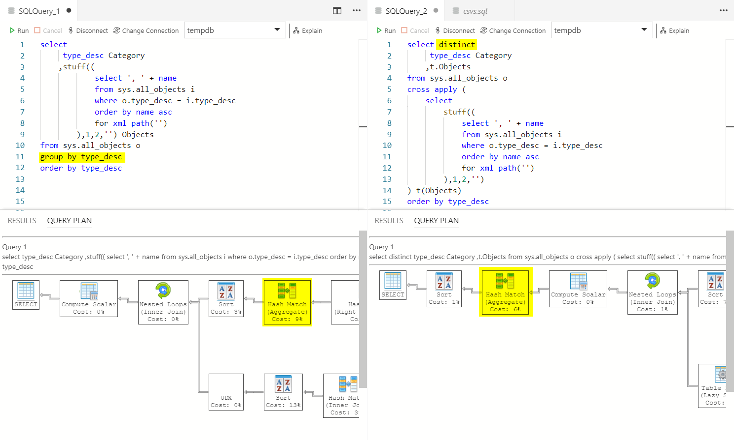

Slide 48
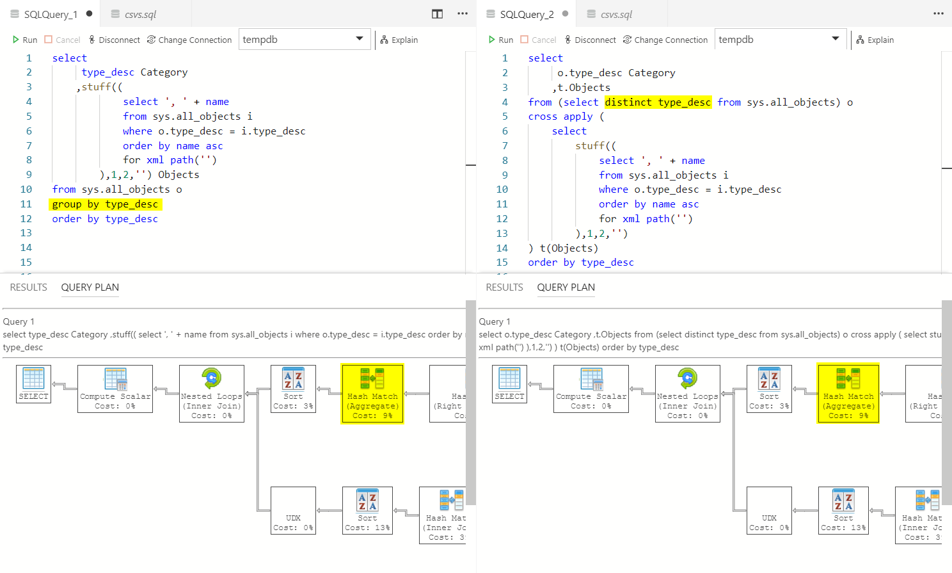

Slide 49
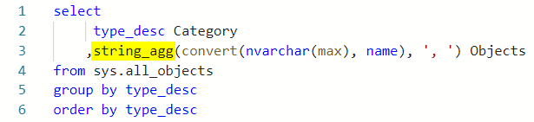
Second Scenario – Lessons Learnt
It matters where you get your information from!
SQL Server and Transact-SQL are changing quickly.
Blog (and Stack Overflow) posts are forever. Technology is not.
Always be critical of what you read. If it looks too difficult, probably it is.
Add msdn or bol to your search.
Try adding specific SQL Server version too.
5 times faster!

Slide 50
It matters how you write your SQL!
It’s not only readability that counts.
Performance matters too.
The two queries are effectively different questions that happen to have the same answer but even with equivalent queries plans can be different.
That is because SQL Server is OK with a good enough execution plan. It will rather run imperfect plan now, than a better plan later. (Check Brent Ozar’s response to Michael J Swart post from the first demo)

Slide 51
Third Scenario
Runnings total and the art of time bomb programming

Slide 52
Third Scenario - Requirements
Write a script that calculates running total of object name lengths.
Order objects by order_id and calculate lengths of their names
Calculate a running total of name lengths by type_desc
Calculate a running total of name lengths overall

Slide 53
Third Scenario – Any Ideas?

Slide 54
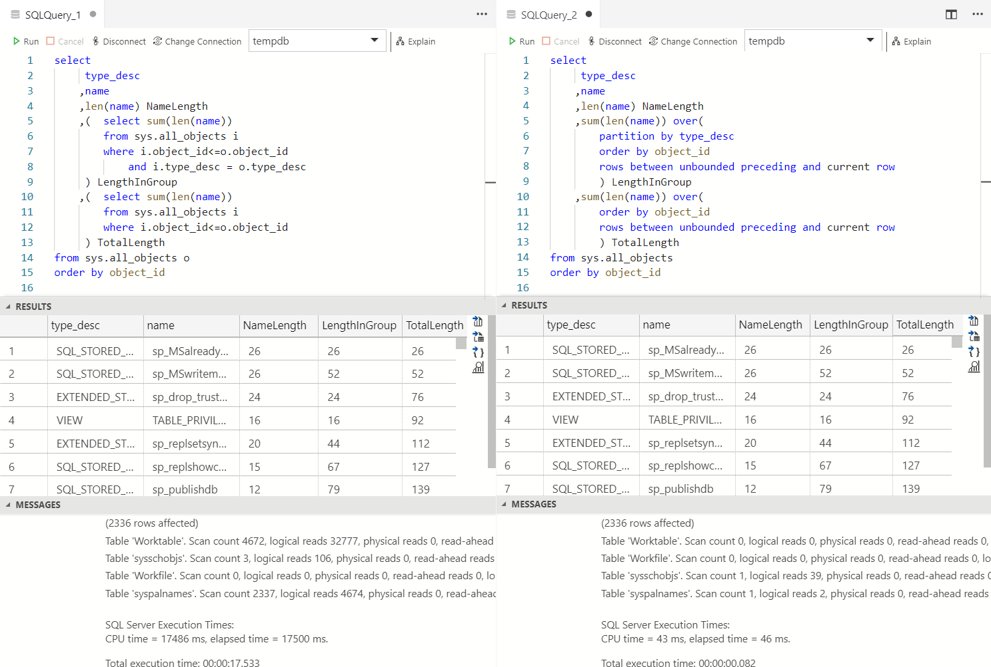

Slide 55
Third Scenario – Lessons Learnt
Cursors are not an option
Careful with subqueries
Learn new features
At least learn about windowing functions ROW_NUMBER, RANK, LAG, LEAD, LAST_VALUE and windowing on aggregate functions SUM, AVG, MIN, MAX

Slide 56
There are no best practices. Just good and bad habits.
Check this link for 100 blog posts about bad habits to avoid
https://blogs.sentryone.com/aaronbertrand/bad-habits-revival/

Slide 57
Questions?

